Slide 1
RADICAL AI GEMINI EXPLORER
BY VEDANTH AGGARWAL
Project : Chatbot with personalized name greetings, unique personality and message history

Slide 2
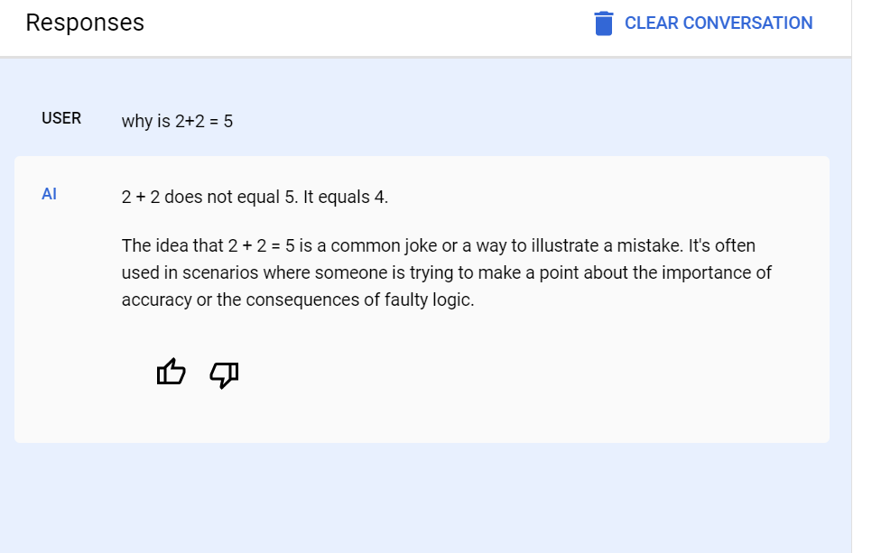
CREATING A GOOGLE CLOUD PROJECT

Slide 3
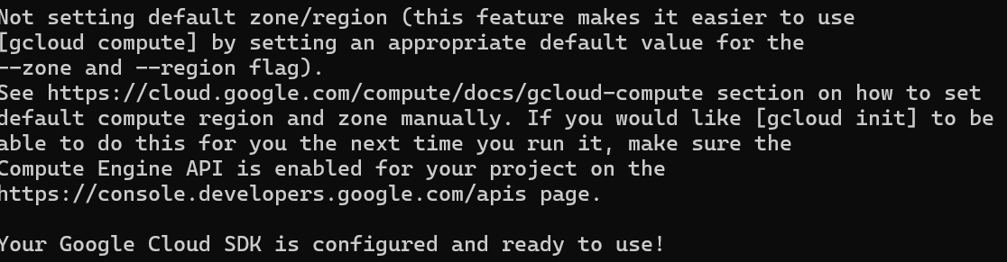
SETTING UP CLOUD SDK

Slide 4
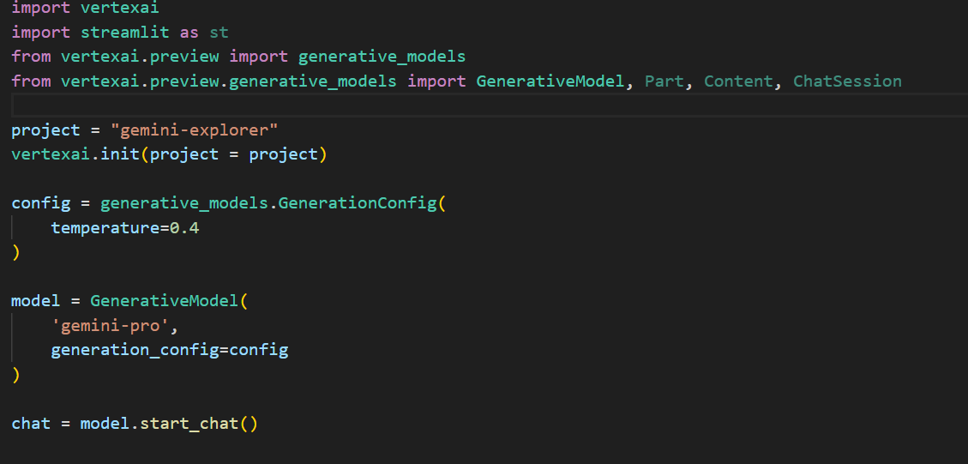
CONFIGURING LLM AND CHAT

Slide 5
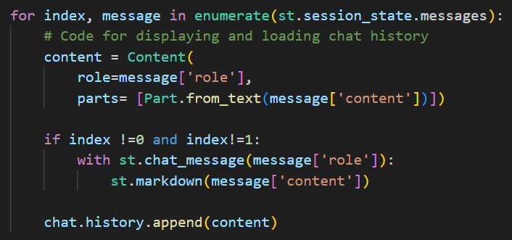
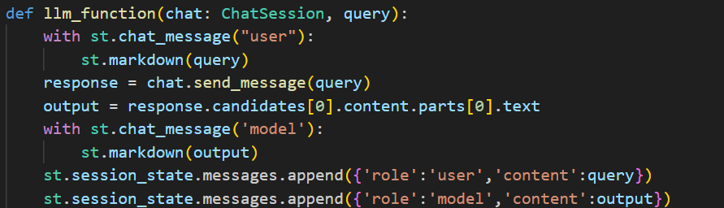
Code snippets

Slide 6
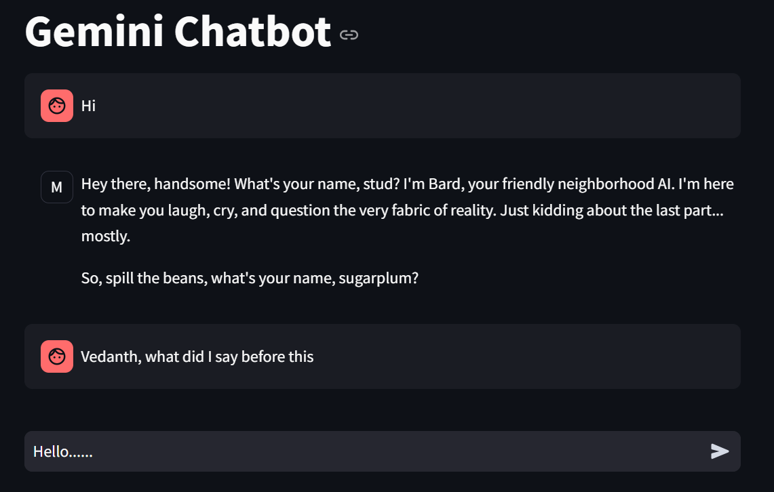
User interface

Slide 7
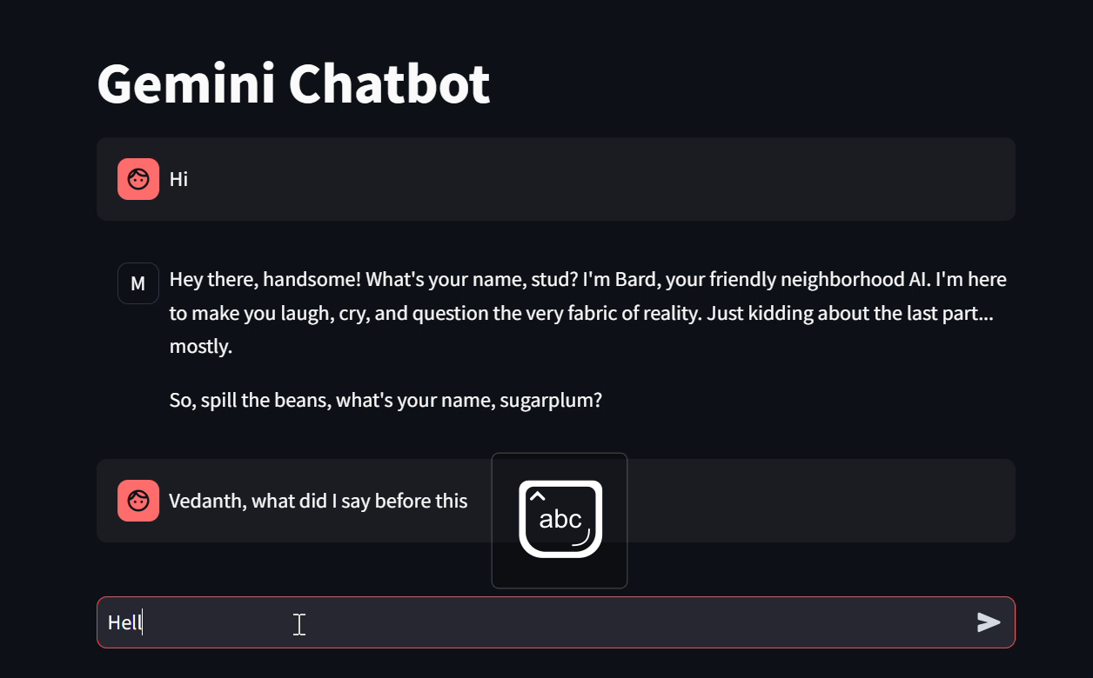
VIDEO DEMO

Slide 8
RADICAL AI GEMINI EXPLORER
BY VEDANTH AGGARWAL

